Slide 1

Getting Started with AutoCAD 2014
JavaScript API
Philippe Leefsma
Autodesk Developer Technical Services
Senior Developer Consultant

Slide 2
Agenda
Introduction to JavaScript
JavaScript API in AutoCAD
Extending AutoCAD JavaScript API

Slide 3
I - Introduction to JavaScript

Slide 4
What is JavaScript ?
JavaScript is a straight-forward scripting language used for client-based Web development
JavaScript is not related to Java other than in its general approach of using a C-like syntax
Originally developed at Netscape under the name Mocha, it was later renamed LiveScript and then JavaScript

Slide 5
JavaScript Structure
Dynamic weakly-typed language: types are associated with values, not variables, allowing a variable to change type as needed
Prototype-based language: does not use classes to define object properties, but prototypes which include methods
Function-based language: functions treated as objects with properties themselves: “first class” functions

Slide 6
Why JavaScript ?
C/Java like Syntax
HTML Scripting
Ajax
JSON
Notes:
C/Java Syntax
The basic Javascript syntax fairly resembles C and since this language is an integral part of Computer Science curriculums all over the world, this means that developers are familiar with it, hence an easy leaning curve.
Omnipresent in HTML scripting
You know it for more than a decade: if you want even the simplest form of dynamic functionality on a web page you need to write some Javascript. For a pop-up window, for client-side form validation, for a calculation, everything melts down to Javascript. There is the alternative of VBScript on IE but since it is not compatible with all the browsers its application is minimal.
It's pretty much the only universally supported client-side (ie, browser) language. In other words, because it's native to the web browser, it's what is used.
There are a lot of SERVER SIDE options (including JavaScript) but for the client-side, there really is only one choice.
AJAX
In the world of Web2.0 it is essential for a developer to understand advanced Javascript. There might be various other approaches for RIAs but still Javascript and XMLHttpRequest is king.
JSON
Although nowadays you can find language specific implementation of this elegant data interchange format in many languages, it was originally used in Javascript and still most applications involve Javascript-based AJAX applications.

Slide 7


JavaScript Tools/IDE
NetBeans
Visual Studio Express 2012
for Web
Firebug

Slide 8
Our First JavaScript code
Coding with JavaScript requires code to be embedded in HTML <script> </script> tags:
<script language=”text/JavaScript”>
alert(“Hello World!”);
</script>

Slide 9
Our First JavaScript code
To use JavaScript code in a browser, you need to embed it within the <html> and <body> tags:
<html>
<body>
<script type="text/javascript">
alert("Hello World!");
</script>
</body>
</html>

Slide 10
JavaScript Variables
JavaScript is not is not strongly typed you simply define the variable name and give it a value. You can reassign a variable value any time with a different type:
<script language=”JavaScript”>
var pi=3.14159;
var helloStr = “Welcome!”;
var myVar1 = “Tuesday”;
var myVar2 = 18;
var myVar3; // myVar3 has no value and no type
</script>

Slide 11
JavaScript Arrays
JavaScript arrays are zero-based, values can be provided during initialization or later on:
<script language=”JavaScript”>
var myArray = new Array(5);
myArray[0] = 0.1;
myArray[1] = 0.2;
myArray[2] = 0.3;
myArray[3] = 0.4;
myArray[4] = 0.5;
</script>
<script language=”JavaScript”>
var DOW = new Array(
"Monday", "Tuesday", "Wednesday", "Thursday", "Friday", "Saturday", "Sunday);
</script>

Slide 12
JavaScript Functions
Functions are used by simply calling them by name with the arguments specified if needed. This is usually done in the <head> section of the page's HTML code. To create a function, define the function by name and enclose the function code in curly braces:
<script language=”JavaScript”>
<!--
function sayHello() {
document.write("Hello there!");
}
// -->
</script>
<script language=”JavaScript”>
<!--
sayHello();
// -->
</script>

Slide 13
Going Deeper…
JavaScript The good parts
By Douglas Crockford
JavaScript The definitive guide 6th edition
By David Flanagan
Eloquent JavaScript
By Marijn Haverbeke

Slide 14
II - JavaScript API in AutoCAD

Slide 15
JavaScript API in AutoCAD
Opens AutoCAD to the JavaScript Web developers
Load JavaScript-enabled HTML into a palette or dialog
Same API shared by AutoCAD WS
Secured by TRUSTEDDOMAINS sysvar
Notes:
To avoid the security warning related to loading the code from a domain, you can add it to the TRUSTEDDOMAINS sysvar:
(setvar "TRUSTEDDOMAINS" (strcat (getvar "TRUSTEDDOMAINS") ";mydomain.com"))

Slide 16
JavaScript API - Features
Prompts, inputs and Jigs
Transient graphics
System variables
View manipulation
Commands definition
Dialogs
Database object events
Bindable object collections
Application object (misc)

Slide 17
Resources
JavaScript API Reference:
http://www.autocadws.com/jsapi/v1/docs/index.html
JavaScript API:
http://www.autocadws.com/jsapi/v1/Autodesk.AutoCAD.js

Slide 18
Code Sample & Demos
Let’s take a deeper look at the AutoCAD JavaScript API through an example…

Slide 19
III - Extending AutoCAD JavaScript API

Slide 20
Extending the API …
From ObjectARX
Acad::ErrorStatus acjsDefun(
const ACHAR* name, JsCallbackType callback);
typedef JSON (*JsCallbackType)(const JSON* params)
From .Net
[JavaScriptCallback("DotNetCallbackFunc")]
public string DotNetCallbackFunc(string json)

Slide 21
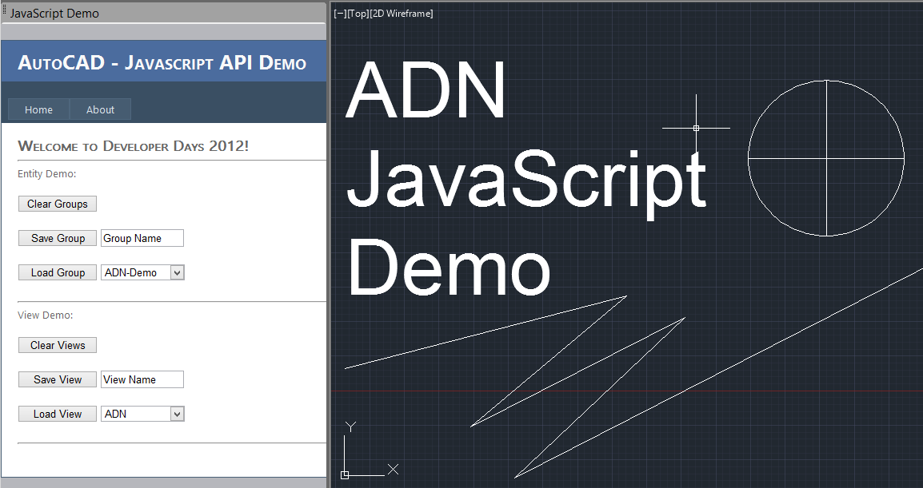
Extending the API … Demos

Slide 22
Autodesk is a registered trademark of Autodesk, Inc., and/or its subsidiaries and/or affiliates in the USA and/or other countries. All other brand names, product names, or trademarks belong to their respective holders. Autodesk reserves the right to alter product and services offerings, and specifications and pricing at any time without notice, and is not responsible for typographical or graphical errors that may appear in this document.

